Slide 1

18CSE392T – Machine Learning I
Department of Data Science and Business Systems

Slide 2
LINEAR REGRESSION

Slide 3
OBJECTIVE - 1
Linear regression analysis is used to predict the value of a variable based on the value of another variable.
Establish if there is a relationship between two variables.
Income and Spending
Wage and Gender

Slide 4
OBJECTIVE - 2
Predict for new observations.
What will be the sales in the next month?
What will be the weather the next day?

Slide 5
Variables
Dependent
Variable
Independent
variable

Slide 6
Dependent Vs Independent Variable
Dependent Variable
---------------------------
Variable we want to explain or forecast
Depend on other variable(S)
Noted by ‘y’
Independent Variable
------------------------------
Variable that explains other variable
Its values are independent
Noted by ‘x’

Slide 7
Basic Idea of Slope
You may remember this slope formula
m – slope
c – y-intercept
y = m x + c

Slide 8
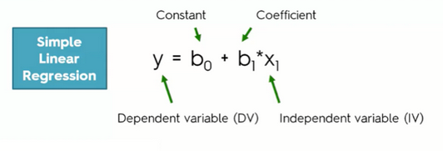
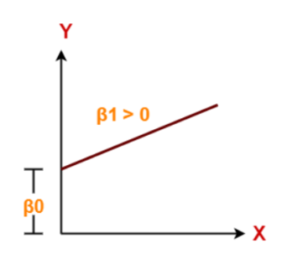
Simple Linear Regression

Slide 9
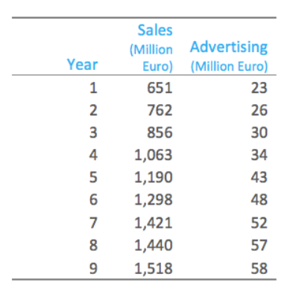
Scenario - SLR
Linear regression estimate
Sales = 168 + 23 Advertising

Slide 10
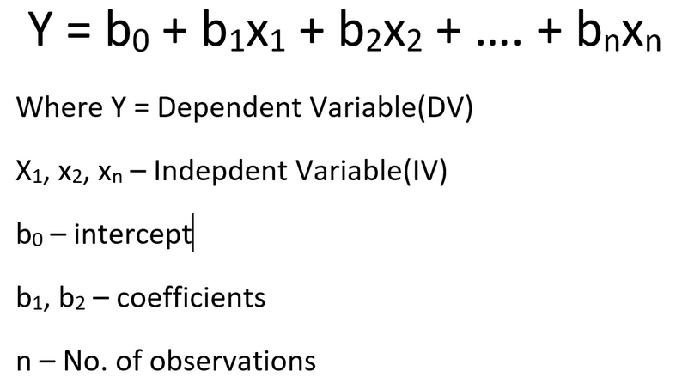
Multiple Linear Regression

Slide 11


